Slide 1
www.vidkom.dk
PhD Dissertation / ”Kappen”
Writing a dissertation
5. December 2021
Morten Pilegaard
mpi@vidkom.dk
Retreat for PhDs and PostDocs
25th August 2022
Morten Pilegaard - mpi@vidkom.dk; - (+45) 26 17 46 22

Slide 2
Basic & Advanced English - Health
Morten Pilegaard
What is a dissertation / “Kappen”
Definition:
What says the Ministerial order?
The PhD dissertation must document the PhD student’s ability to apply relevant research methods and to conduct research work meeting international standards for PhD degrees within the field in question.
The PhD dissertation may be either a monograph or 3-5 scientific articles including a summary account of the relation between the publications and their individual contribution to the complete PhD project.
The monograph as well as the collection of scientific articles must include research contributions which have been published in or are potentially publishable through recognised publishing channels.
Some variation across AU faculties
Molec Biol
Health
BSS
Notes:
Growing evidence demonstrates widespread

Slide 3
Basic & Advanced English - Health
Morten Pilegaard
“Kappen” - Function/definition
Definition:
”Kappen” (3-5 independent scientific articles) must be
an independent work that documents the whole
summarises the articles’ issues, methods, findings and conclusions in a comprehensive perspective
summarises the thesis’ contribution to the field of research – both theoretical and practical
accounts for & discusses methods used, choices made & strengths and weaknesses of choices
suggests future work and potential application
The Kappen should connect findings, methods and theoretical problems considered in individual papers
The thesis is an independent endeavour; must be written by the PhD student him/herself
Volume: 60-80 pages in English
Summary account
Summary
Summary
Explain connectedness between individual papers
Invitation to discussion of theory and methodology
Notes:
Growing evidence demonstrates widespread

Slide 4
Basic & Advanced English - Health
Morten Pilegaard
“Kappen” - Structure
Macrostructure
Microstructure
First pages
Culture
Formal written language
Front page (no page no)
Title
Author
Logo
Year of submission
Page 1 (no page no)
Date of submission
PhD supervisor
PhD committee
PhD series ISSN, ISBN
Published by
Page 2 (no page no)
CV + Picture
List of contents
Kappen
Preface
Introduction
Literature review
Sender
Theory & concepts
Receiver
Method
Results
Discussion
References
Appendix
UK English

Slide 5
Basic & Advanced English - Health
Morten Pilegaard
“Kappen” - Structure & language
Useful phrases
Microstructure
First pages
Front page
Title
Author
Logo
Year of submission
Page 1
Date of submission
PhD supervisor
PhD committee
PhD series ISSN, ISBN
Published by
Page 2
CV + Picture
List of contents
Professional CV + picture
X was born in; acquired a Bachelor’s Degree in .. in 200?; graduated as a medical doctor in ..; completed x months of internship in …; held a position as a … at … in … His/her first scientific work was in the area of …, where he/she had a x-month internship as a ..X did his/her first project in ..20 based on

Slide 6
Basic & Advanced English - Health
Morten Pilegaard
“Kappen” - Structure & language
Useful phrases
Microstructure
Often personal motivation
First pages
Preface
The idea originates from…
The goal was…
The thesis was conducted at ..
English summary
2 pages!
Danish summary
Please proofread!
Acknowledegement
Supervisors, coauthors, colleagues, funding sources, participants, family
Preface
List of papers
Abbreviations
List of papers
This thesis is based on the following xx papers referred to by their Roman numerals
In addition, contribution has been made to the following papers ….
-Politeness
-Don’t be humorous
Always check meticulously

Slide 7
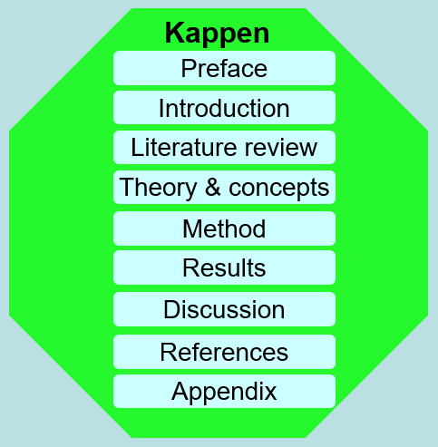
Basic & Advanced English - Health
Morten Pilegaard
“Kappen” - Structure & language
Macrostructure
Microstructure
Introduction
Introduction
Background or literature review
CARS (research niche)
Thesis objectives/aims
Introduction (short scene-setting section; 2-3 pages
X is …(brief description of topic)
The problem in X is (brief description of problem)
Our focus is (briefly on rationale of approach)
The thesis is based on n studies (briefly state aim of each study)
OR start with an important quote (literature or other)
Ordinary page numbers
Headings with decimal numbers

Slide 8
Basic & Advanced English - Health
Morten Pilegaard
“Kappen” - Structure & language
Macrostructure Structure
Microstructure
Introduction
Introduction
Literature review or background
CARS (research niche)
Thesis objectives/aims
Background (detailed introduction to current state of affairs/situation = extended paper introduction)
2. Outline of structure: This chapter introduces the background for the thesis. It gives a general introduction to …. The chapter also describes current … and offers perspectives on current challenges. This leads to a section that presents ….
2.1. Background; 2.2. Current situation; 2.3...
2.n: Background summary / at a glance

Slide 9
Basic & Advanced English - Health
Morten Pilegaard
“Kappen” - Structure & language
Macrostructure
Microstructure
Introduction
Introduction
Literature review or background
CARS (research niche)
Thesis objectives/aims
3. Thesis objectives (follow naturally from niche, comes at the end of the literature review)
3. The aims of the PhD study were: … 1) to estimate … We hypothesized that …; 2) to investigate …. We hypothesized that …, etc.
Tabular overview
Study | Title of paper | Research objective(s) | Study approach(es)

Slide 10
Basic & Advanced English - Health
Morten Pilegaard
“Kappen” - Structure
Macrostructure Structure
Microstructure
Methods/results
Study-by-study approach
Study 1
Theory/concepts/methods (short, concise)
Results (outcome by outcome)
Conclusions (closely aligned with aims)
Study 2, do
Study 3, do
This chapter summarises the work conducted in the paper entitled “xxx” (1). The summary focuses on the methods, results and conclusions

Slide 11
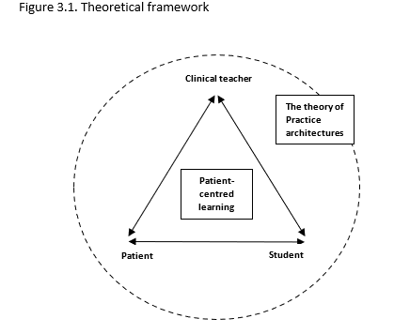
Basic & Advanced English - Health
Morten Pilegaard
“Kappen” - Structure
Macrostructure
Microstructure
Methods/results
Traditional structure
Methods (study-by-study/overall)
Setting
Data sources
Definitions
Study designs
Study populations
Outcomes
Statistical analysis
Results
Ethics
Study I
Study II…
Simple graphics!
Theoretical framework
Simple graphics!
Data sources

Slide 12
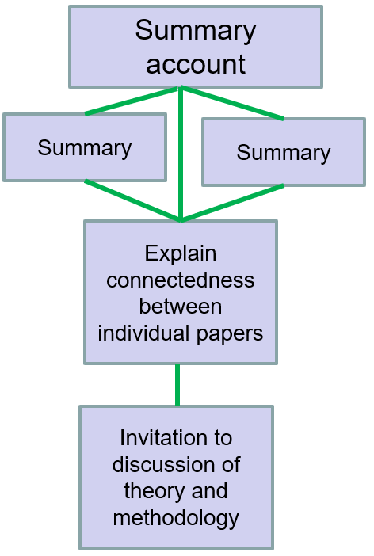
Basic & Advanced English - Health
Morten Pilegaard
“Kappen” - Structure
Macrostructure
Microstructure
Discussion
Summary of main findings
Briefly recap background & aim
Summarise main findings
Interpretation of main findings
Subjective assessment of results
Compare/contrast with others’ results
Methodological considerations
Assess strengths/weaknesses
Selection bias, information bias, confounding etc.
Conclusions
Perspectives & future research
Often separate main headings

Slide 13
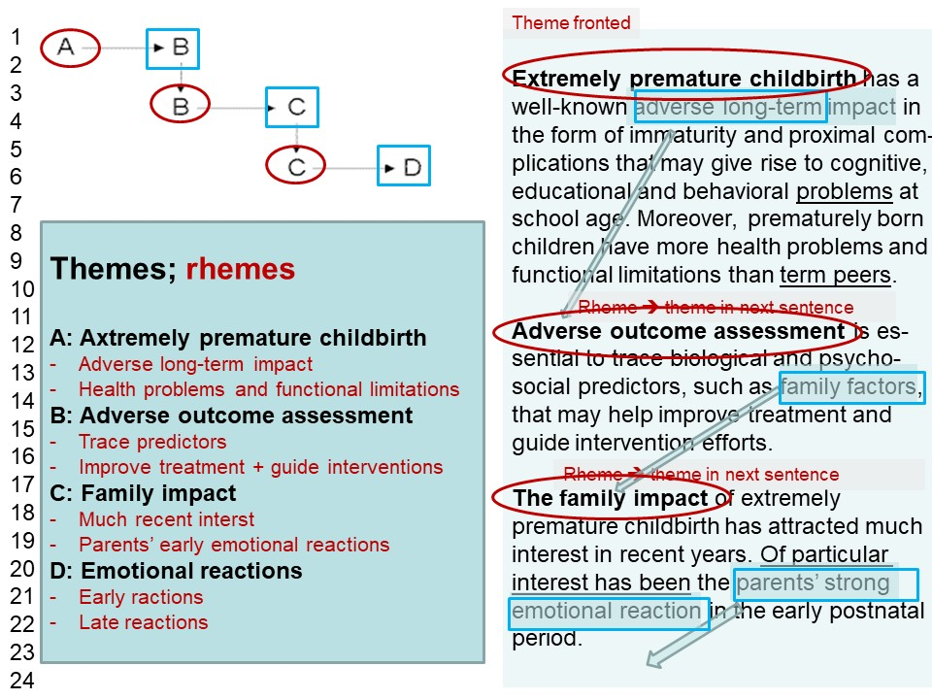
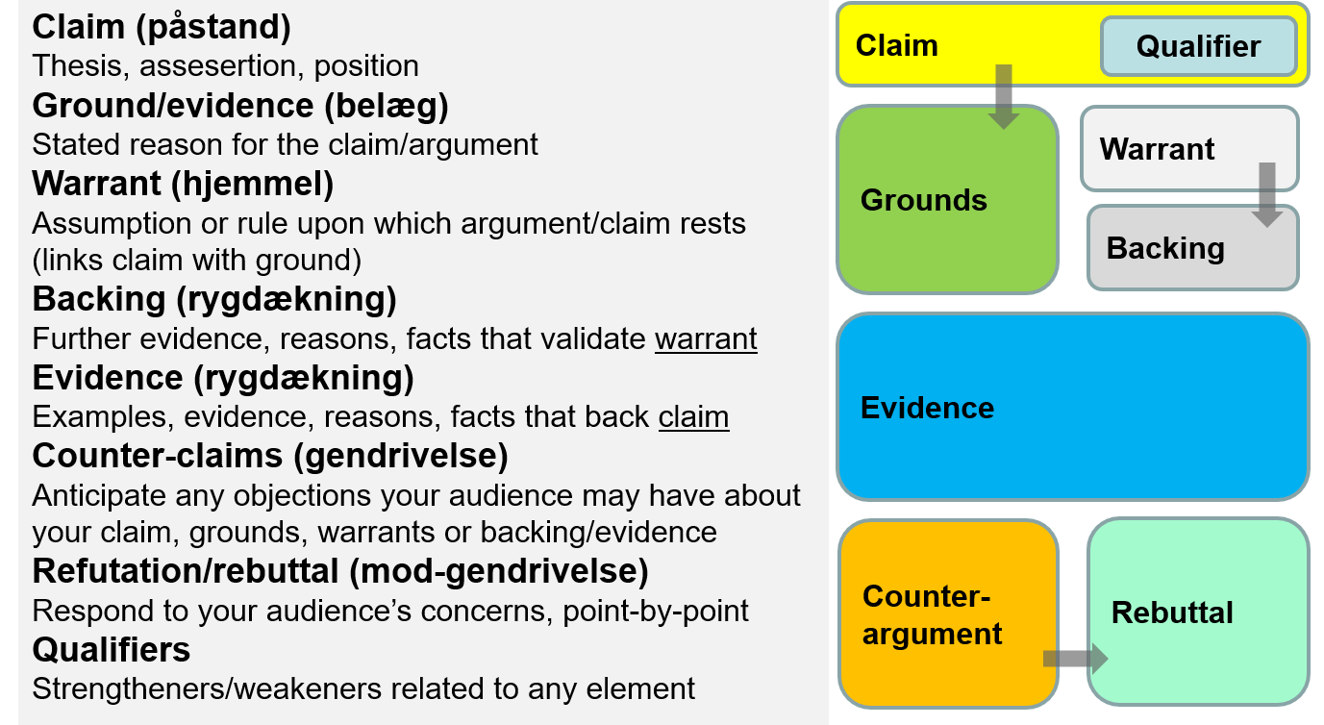
Basic & Advanced English - Health
Morten Pilegaard
“Kappen” - Advice on writing process
1. Start early (unforeseen difficulties, hyper optimism, waiting time…)
2. Work professionally (plan text meticulously)
3. Get help (know your strengths and weaknesses; VidKom)
4. Be ambitious (your work will stand for many years)
5. Plan a good defence (know & relate to weaknesses; prepare!)

Slide 14
Basic & Advanced English - Health
Morten Pilegaard
Supplementary materials
1. AU (Health): Template (Word): “Overwrite …”
2. AAU: AAU dissertation template video
3. Uniped: Kappen: "One size fits all"?
4. Professional assistance
Quote (60-80-page Word document): DKK 68-8600 (± 10%) net
Time: 7-10 days pending 30 days’ notice
Two professional translators / copyeditors

