Slide 1
iNANO Mentor Program
iNANO
Lazaros Primpas
Steffen Holleufer
Therese Kjær
Notes:
Hey Everybody! This is Thomas and my name is Anders and we are from the Science Mentor program at iNANO. We have the pleasure of finishing off with a short presentation this afternoon before we leave for dinner.
If you are a part B phd student at iNANO or soon to become one, you are probably wondering about the same two things that I am constantly thinking about:

Slide 2
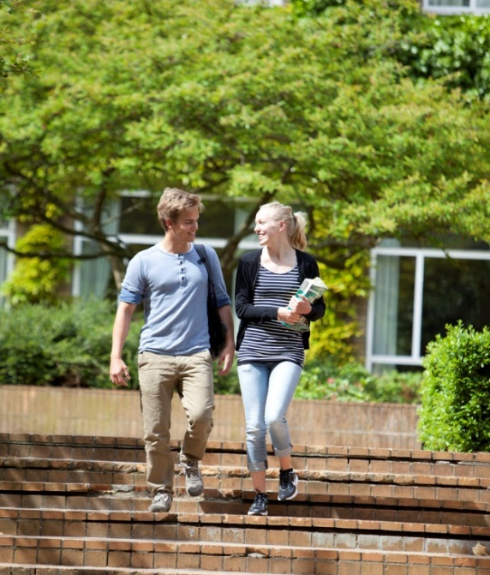
Why get a mentor?
Experience industry based on educational background
3 meetings
Get valuable advice on your career
Notes:
So if you have not heard about the science mentor program before, we will just quickly go through the most important points.
With the science mentor program you can get a mentor in an industrial company here in Denmark.
And a mentor is a person who has been working outside the University in a job that you find interesting.
If you apply for the mentor program you will get 3 meetings with your mentor. Here you can discuss career choices, talk about the daily work in the company and get valuable advices from your mentor.
The match between you and your mentor will be done by us according to your scientific interests and the type of position you look for. You can for example be matched with a researcher or an administrative mentor depending on your preferences.
This gives you an exclusive opportunity to experience your dream job before you get your degree and to build up a network at a potential future employer.

Slide 3
Expectations to you
Well prepared for meetings
Meet on the mentor’s terms
PhD Student at iNANO
Notes:
So if you have not heard about the science mentor program before, we will just quickly go through the most important points.
With the science mentor program you can get a mentor in an industrial company here in Denmark.
And a mentor is a person who has been working outside the University in a job that you find interesting.
If you apply for the mentor program you will get 3 meetings with your mentor. Here you can discuss career choices, talk about the daily work in the company and get valuable advices from your mentor.
The match between you and your mentor will be done by us according to your scientific interests and the type of position you look for. You can for example be matched with a researcher or an administrative mentor depending on your preferences.
This gives you an exclusive opportunity to experience your dream job before you get your degree and to build up a network at a potential future employer.

Slide 4
Who’s in it so far?
100+ iNANO master students and PhD’s
Notes:
So who is in it so far?
The Science mentor program has been running for 3 years and so far already 23 inano phd students have been assigned to a mentor.
We have found mentors in a wide range of different companies. They are all shown here. To mention a few you can for example get a mentor at novo nordisk if your interests are in the field of healthcare or Haldor Topsøe if you are more into catalysis and surface science.
But other companies are also possible! And you can suggest them to us if you do not find them here.
Notice that all you have to do is apply. We will find the right mentor for you.

Slide 5
Who’s in it so far?
Notes:
So who is in it so far?
The Science mentor program has been running for 3 years and so far already 23 inano phd students have been assigned to a mentor.
We have found mentors in a wide range of different companies. They are all shown here. To mention a few you can for example get a mentor at novo nordisk if your interests are in the field of healthcare or Haldor Topsøe if you are more into catalysis and surface science.
But other companies are also possible! And you can suggest them to us if you do not find them here.
Notice that all you have to do is apply. We will find the right mentor for you.

Slide 6
Previous opinions
”The insights about career development”
”Networking”
“It was great to talk to someone already working in the industry about the issues of changing from academia to industry.”

Slide 7
Application deadline
11th of November, 2024
Notes:
The most important for you to remember from our short presentation is that the deadline for applying for the mentor program is November 1st. That is why we dedicated a whole slide for it. That is 20 days from now. It is really easy to apply, you only have to take three simple steps.

Slide 8
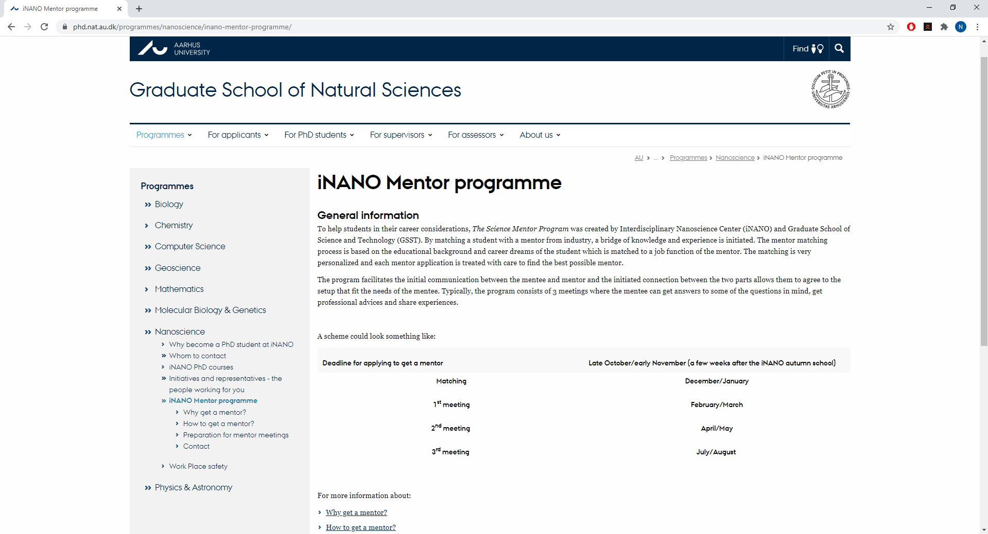
Where do I go?
Notes:
First, go to inanoschool webpage. Here you will find a link for phd students. If you click there, you will get to a new page where you can choose “mentor” and then you are at the science mentor program webpage.
And here you can also find a lot of other information about the science mentor program.

Slide 9
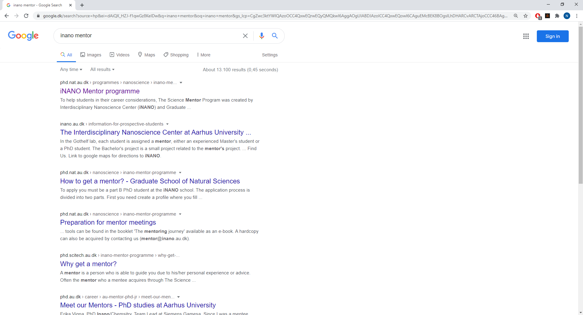
Other ways to find it

Slide 10
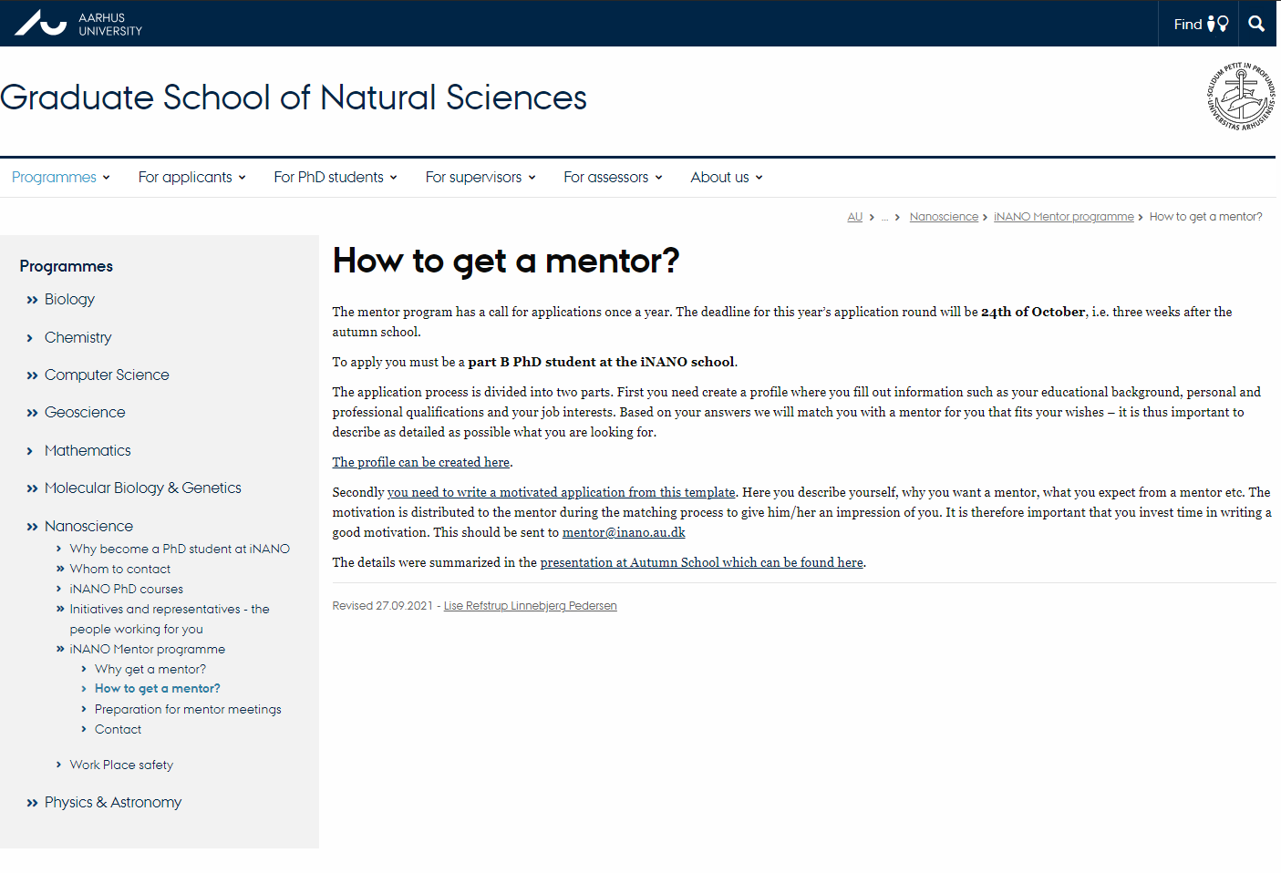
How do I apply? - Form
Notes:
The next step in the application process is just to fill in a simple form where you put in general information about yourself. I’ve put in some details for me – this takes no more than a few minutes.

Slide 11
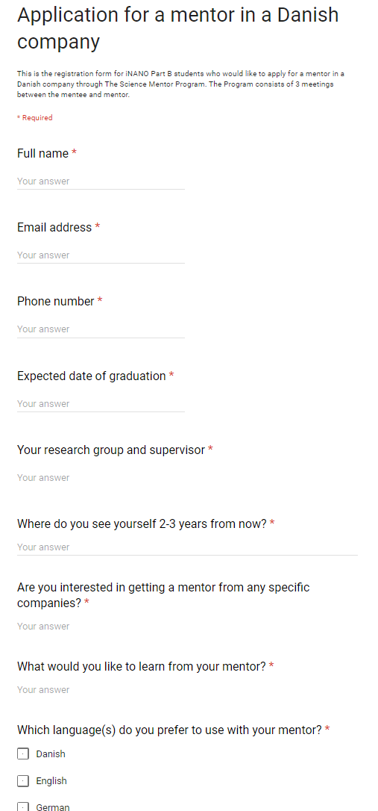
How do I apply? - Form
Notes:
The next step in the application process is just to fill in a simple form where you put in general information about yourself. I’ve put in some details for me – this takes no more than a few minutes.

Slide 12
Motivational letter 1 A4 page
[Put your name here]
Please write a maximum of one A4 page including the
following and save it as a Word document (.doc or docx):
A motivated application with a short description of yourself
A picture of yourself (please replace the default profile picture in the document)
A short description of your expectations to the iNANO Mentor Program
What your work place of your dreams would be like including the job functions you would like to have
What your mentor can expect of you
The application will be forwarded to your mentor before your first meeting.
Notes:
In addition to the form, you should send a motivational letter no longer than one page. It should include a short description of yourself and some thoughts on what your expectations are and what you want to get out of participating in the science mentor program. You should also include a photo of yourself.
Please also notice that this motivational letter will be forwarded to your mentor before the first meeting. This is just for the mentor to be prepared in the best way.

Slide 13
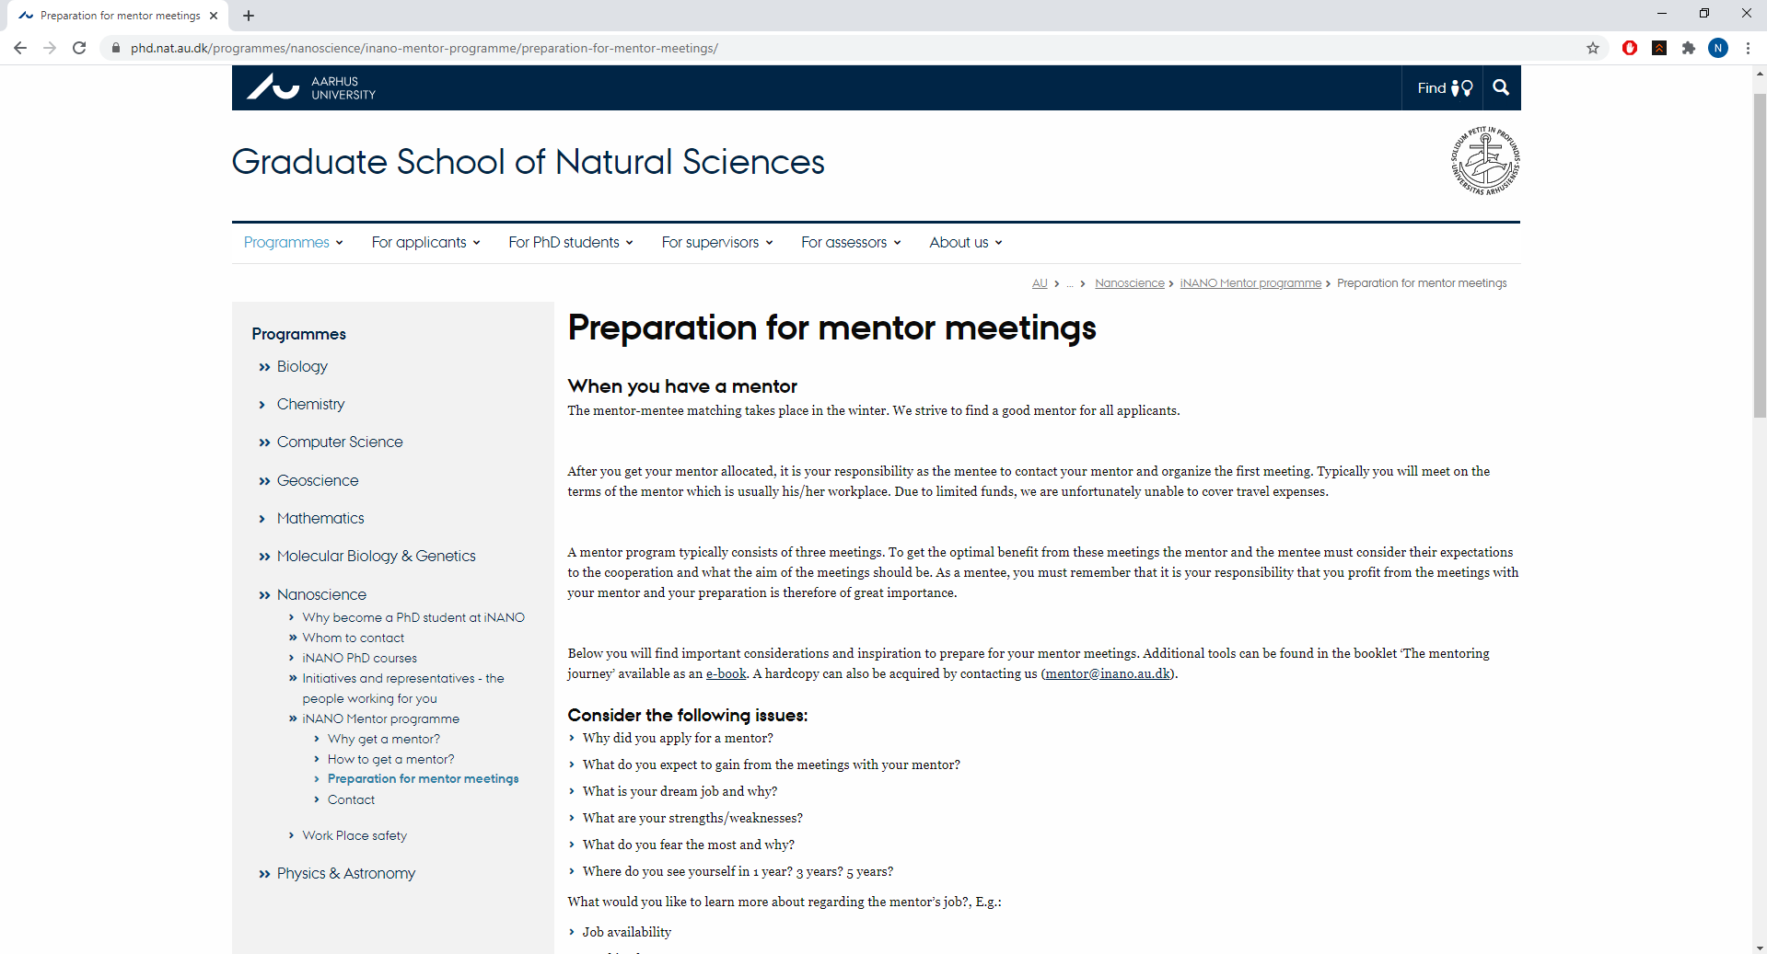
Preparation resources
Notes:
The next step in the application process is just to fill in a simple form where you put in general information about yourself. I’ve put in some details for me – this takes no more than a few minutes.

Slide 14
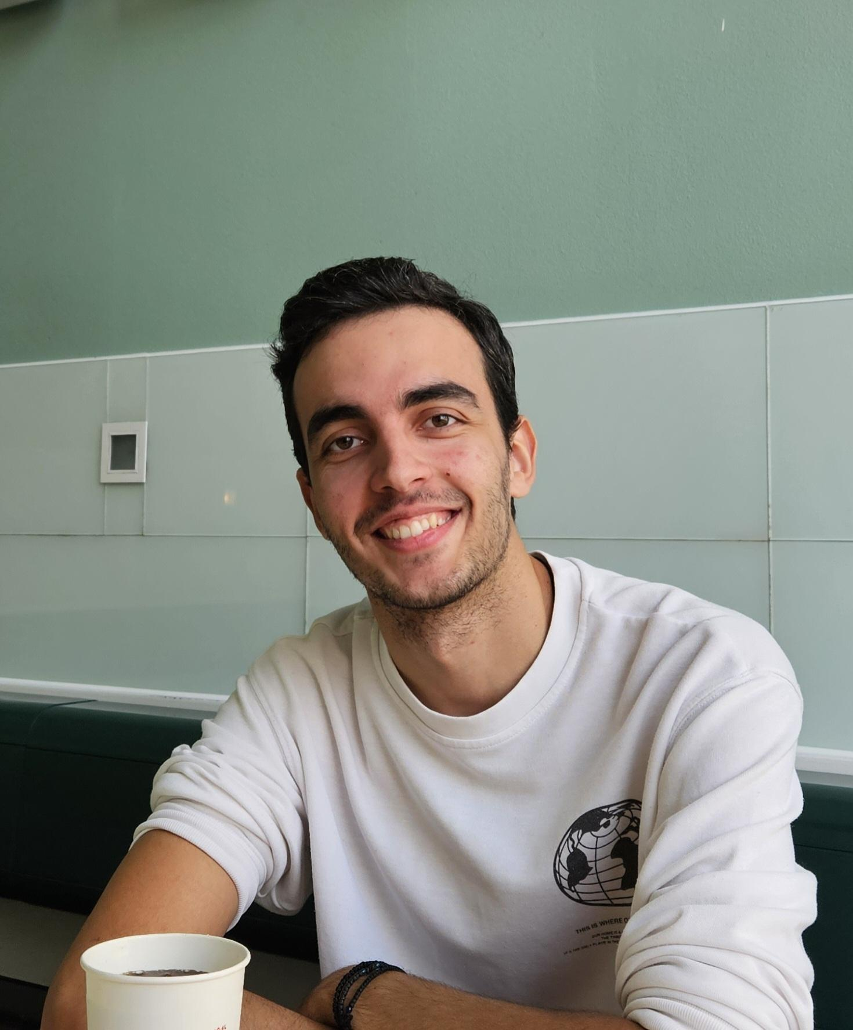
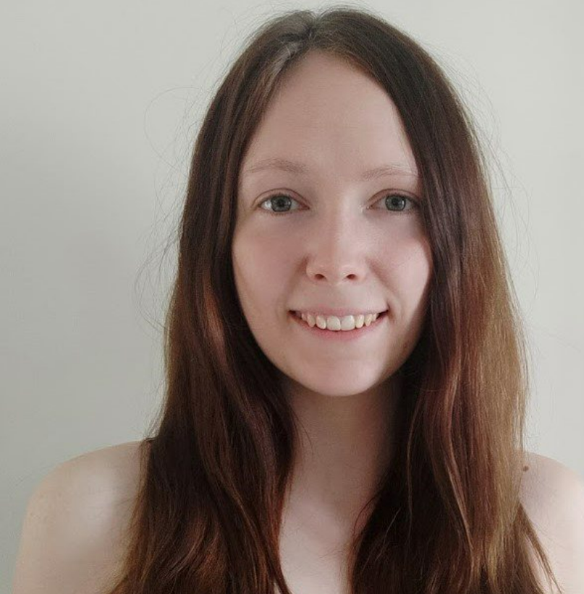
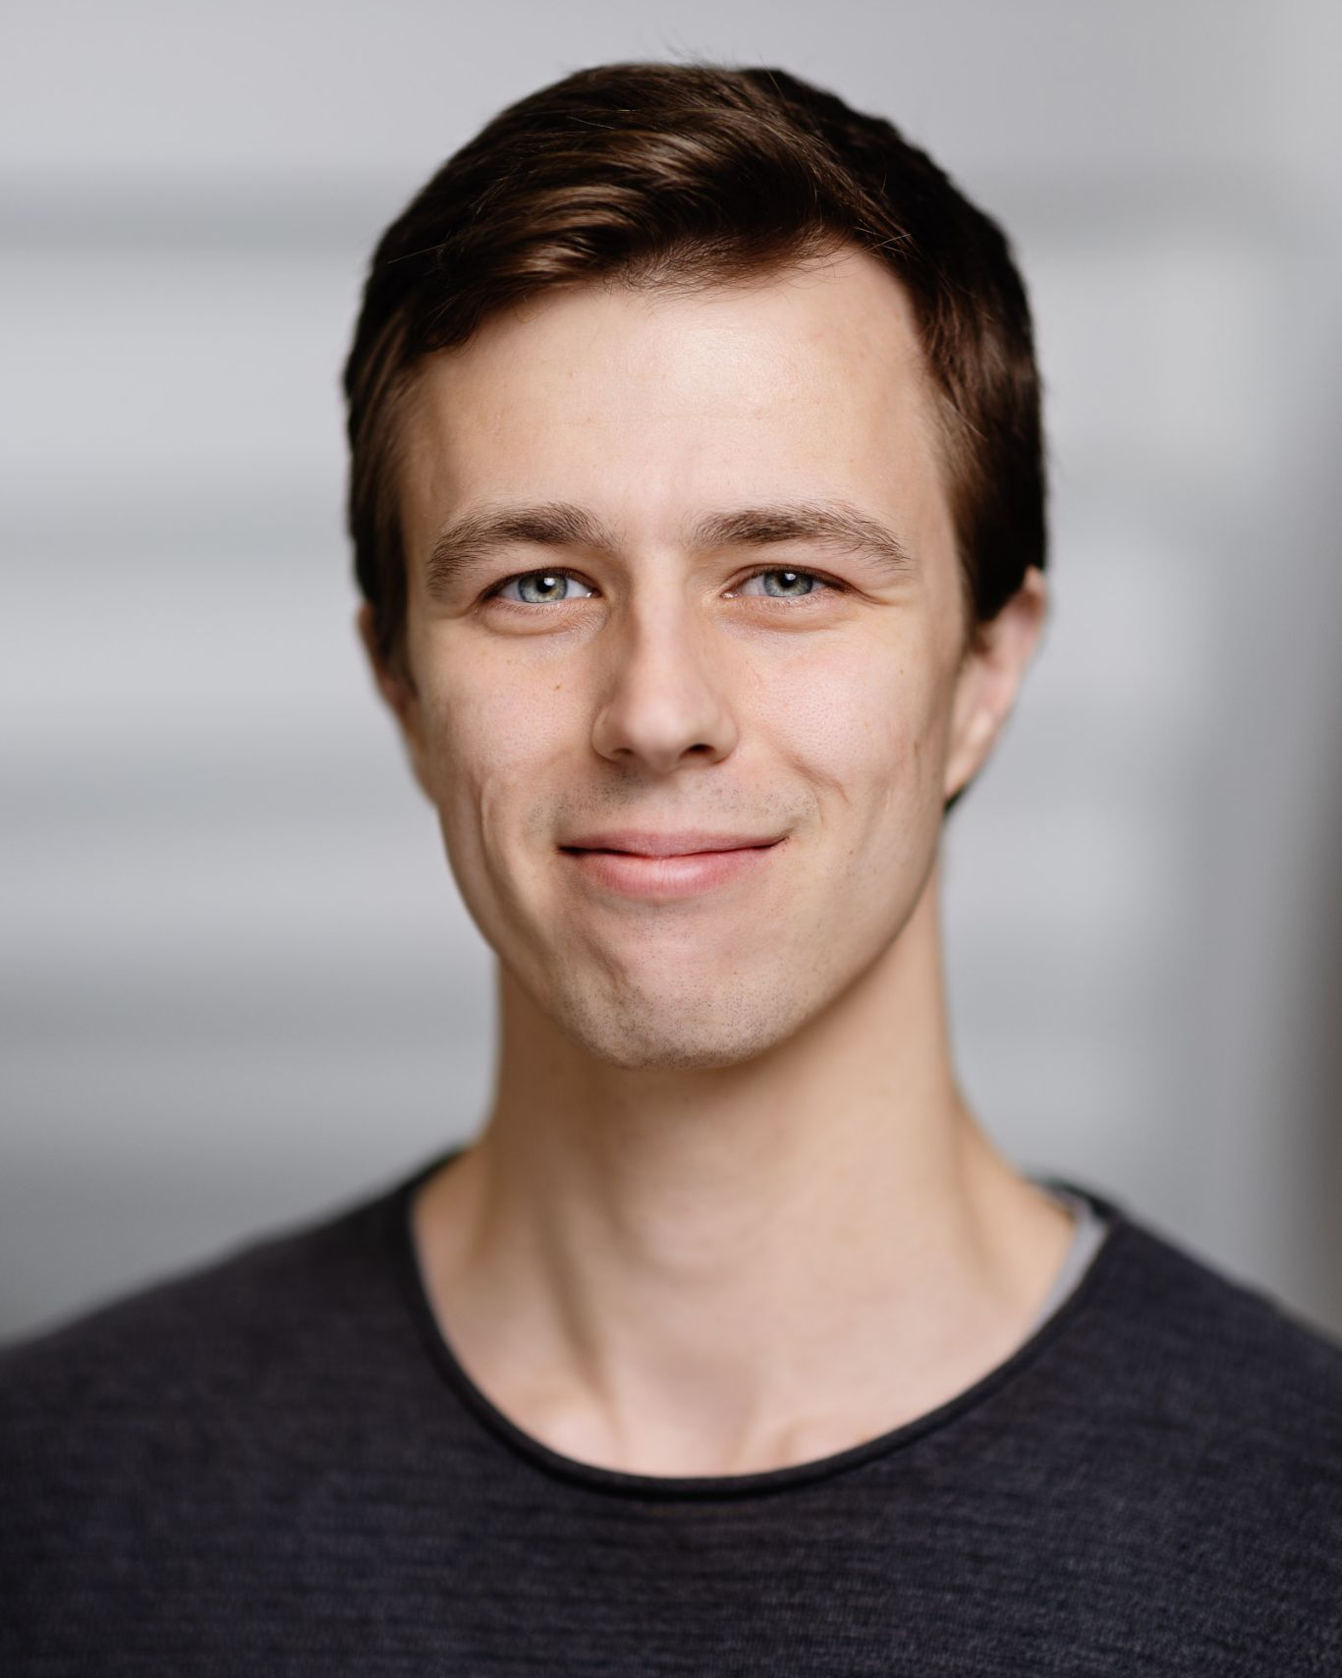
Want more information?
Lazaros Primpas
lapr@inano.au.dk
Therese Kjær
therese@inano.au.dk
Steffen Holleufer
sfholleufer@inano.au.dk
mentor@inano.au.dk
Notes:
Thank you for sharing that with us Sarah
We are always told to deliver a take home message when speaking at iNANO venues. So here it is ☺
The science Mentor program is for part B students who wants a mentor in an industrial company.
It is easy to apply, just fill in a form and write a letter– and you will get much more in return for that small investment.
And finally the deadline for application is 1st of november.
If you have any question about the science mentor program please do not hesitate to ask Thomas or me here at the autumn school or at the university. You can also send us an e-mail on mentor@inano.au.dk.
Thank you for your attention!

Slide 15
How do I apply? - Form
Full name
Nicolaj Brink Søgaard
Email address
mentor@inano.au.dk
Phone number
12 34 56 78
Expected date of graduation
June 2023
Research group and supervisor
Brian Julsgaard, The Semiconductor Group
Somewhere warmer…
Where do you see yourself 2-3 years from now?
Would you like a mentor from any specific companies
Teknologisk institut
Preferred language
Dansk
Notes:
The next step in the application process is just to fill in a simple form where you put in general information about yourself. I’ve put in some details for me – this takes no more than a few minutes.

